Slide 1
Catharsis
Programmer: Haolun Zhang
Artist: Qingxiang Chen

Slide 2
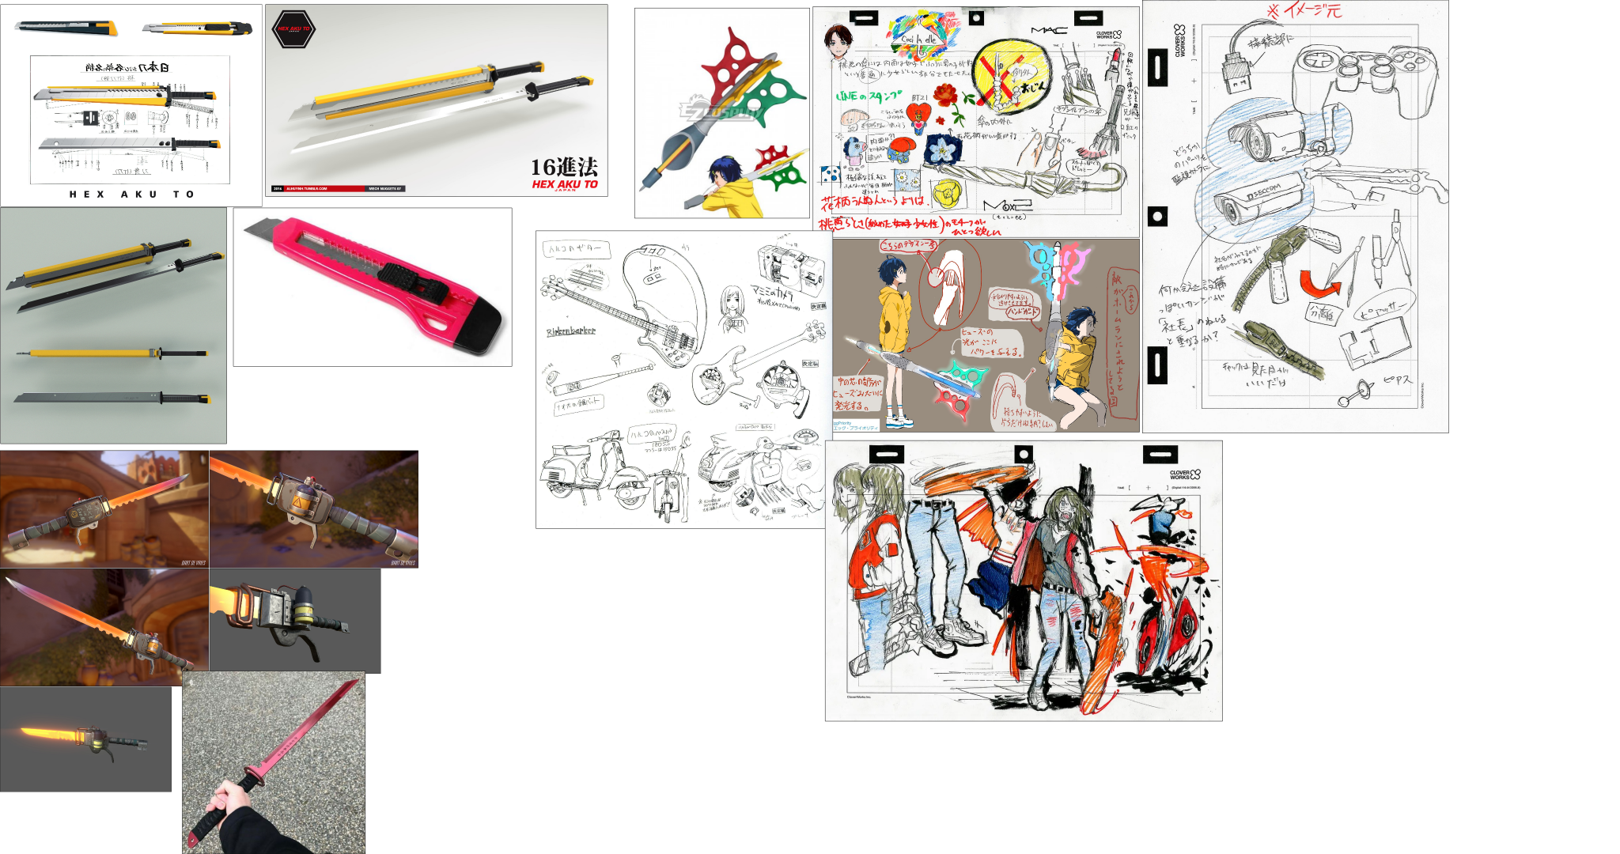
Weapon Concept
The transformation of stationery
Related to our main character and the storyline.
Stylized texture (toon/semi-realistic/unrealistic)

Slide 3
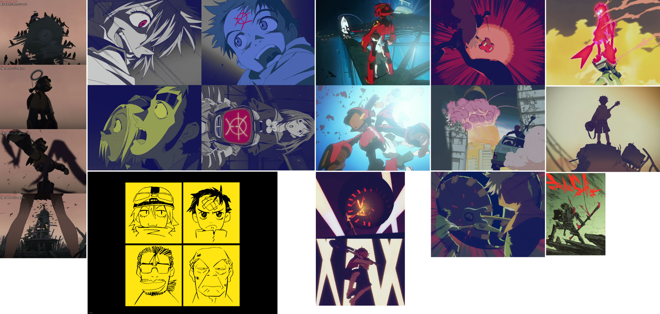
UX/ Emotional Concept #1
Notes:
There is a sense of comics, violence (wildness), the storyline is stream of consciousness, but everyone who was or is young can be moved! (Fooly Cooly)

Slide 4
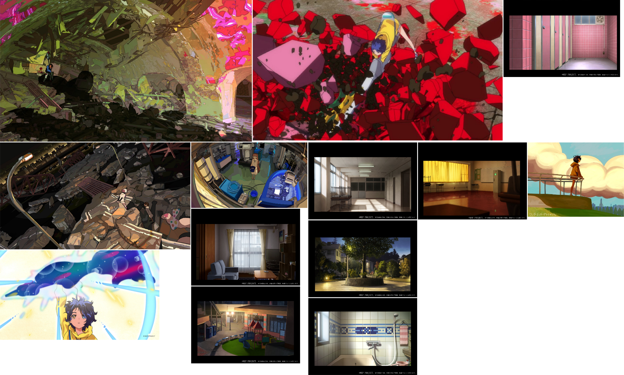
UX/ Emotional Concept #1
Notes:
worries of adolescence, compared to FLCL, …（Wonder Egg）

Slide 5
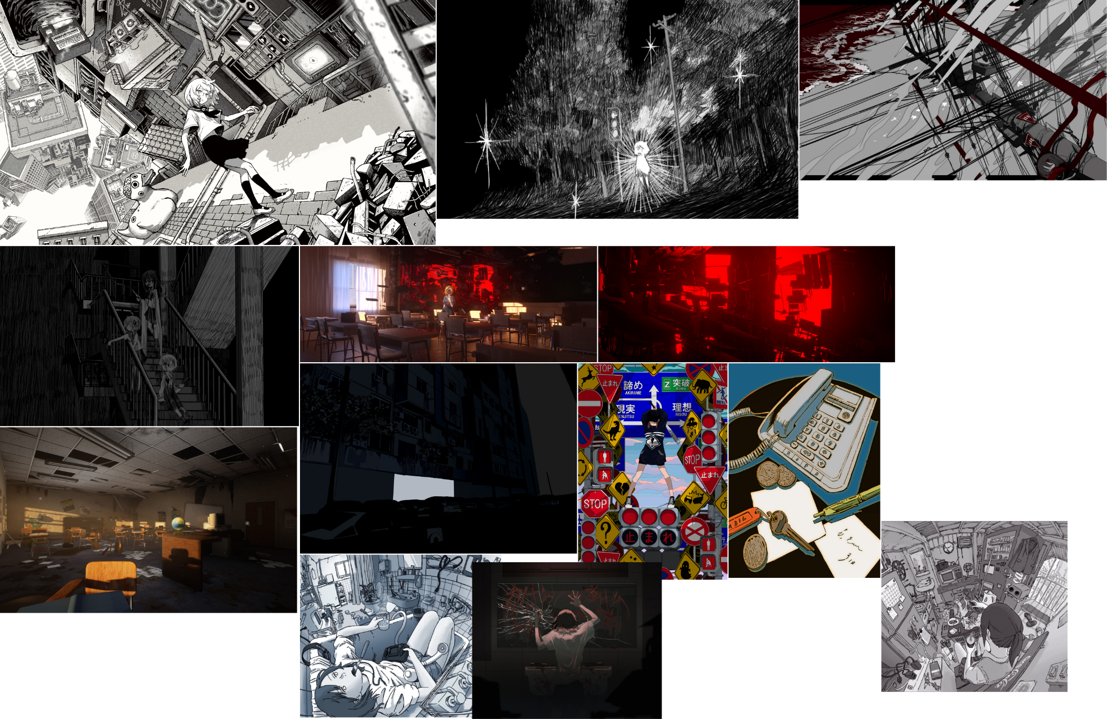
Other References
Notes:
Reduce the amount of colors in one scene
High contrast but low saturation (pain/ vintage)
Full of floating objects
Related to our story, reveal the mood changes of our character
The emotions are strong, anger mixed with depression
The environment will be rendered unrealistic/ anime-like.

Slide 6
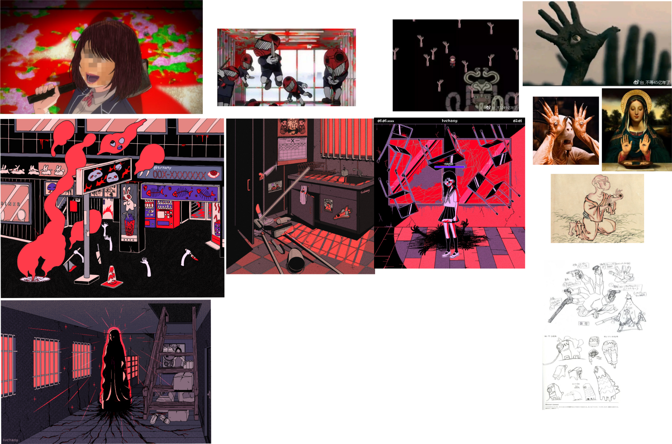
Enemy Concept
Embodiment of negative phenomena/negative emotions in real society
There are some religious, mythological references

Slide 7
Possible Scenarios
Subway
Office
Other depressive scenes

Slide 8
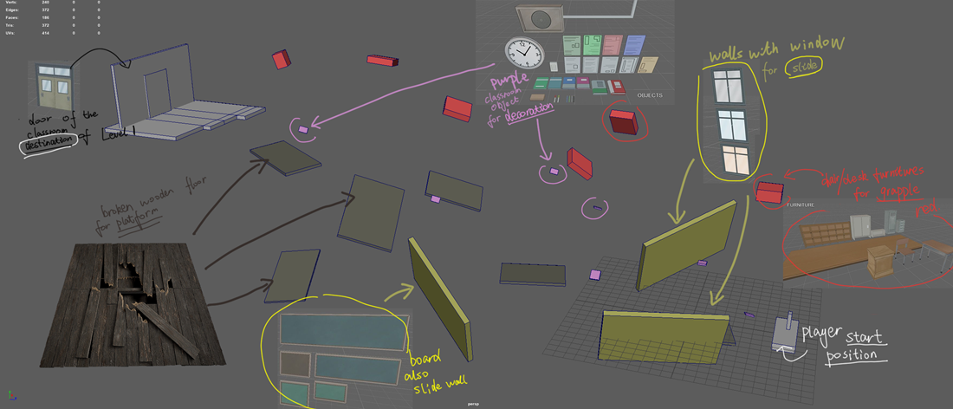
Level 1 Design - objects/ arrangement

Slide 9
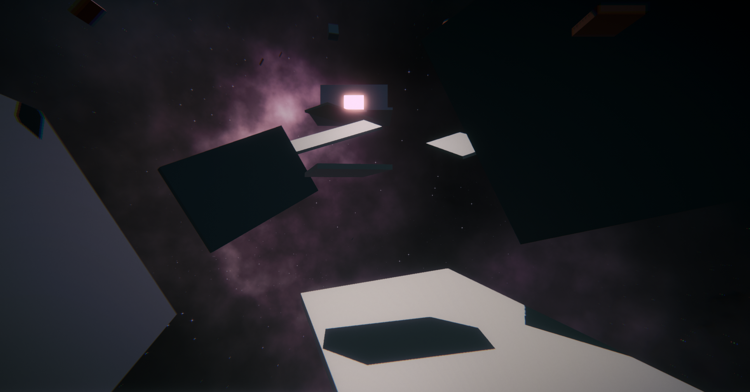
In-progress

Slide 10
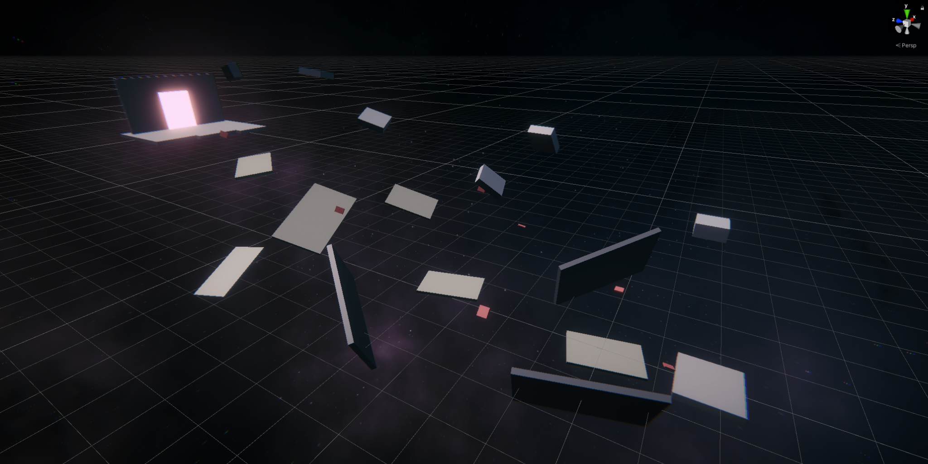

Slide 11
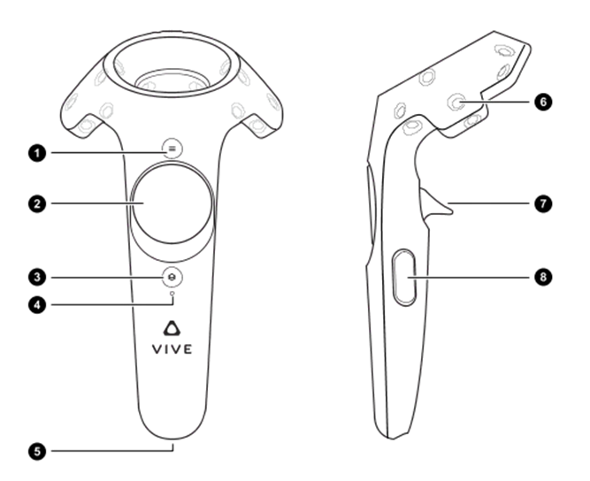
Controls
•Basic Movement: Locomotion by left control pad
•Jump: Left Trigger
•Grapple: Left Grip
•Bullet Time: Right Trigger
•Wall Sliding: Left control pad
•Dodge: Physical body movement
•Shell Blocking
•Skills: Right control pad + Gesture
•Drag using grapple

Slide 12
Key elements of future plan
Level design (more elements and more fun)
More controls and movement optimization
More visual effects
More art assets
Audio

